Slide 1

UML Sequence Diagrams
Dr Rami Bahsoon
School of Computer Science,
University of Birmingham
r.bahsoon@bham.ac.uk

Slide 2
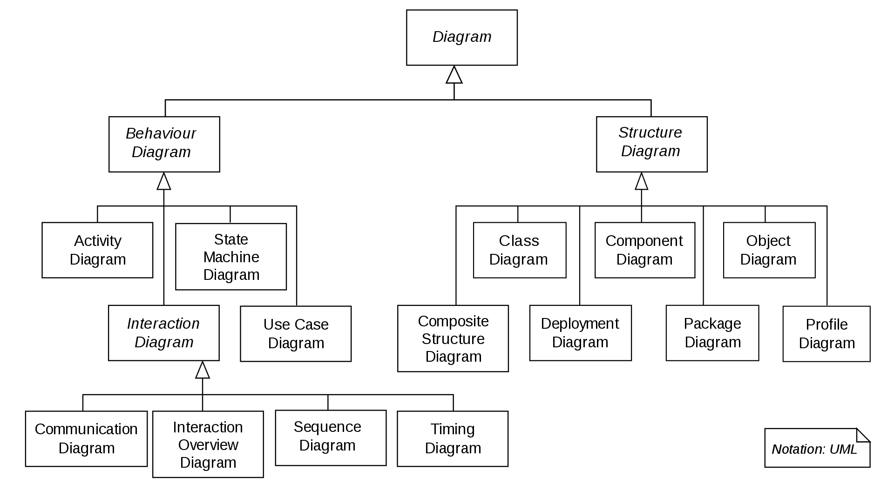
UML 2.X
UML 2.X
Collaboration Diagram

Slide 3
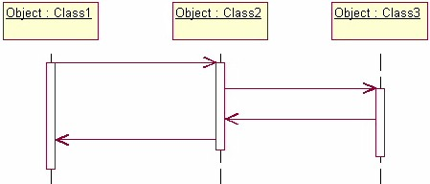
Sequence Diagram
An “interaction diagram” that models a single scenario (i.e. a use case) executing in the system
– one of the most common UML diagrams
Demonstrate the behavior of objects in a use case by describing the objects and the messages they pass.
The diagrams are read left to right and descending.
Object interactions arranged in a time sequence (i.e. time-oriented)
objects
Life-time
Activation:
i.e., object in active

Slide 4
A Basic Sequence Diagram
The example shows an object of class 1 start the behavior by sending a message to an object of class 2. Messages pass between the different objects until the object of class 1 receives the final message

Slide 5
A Basic Sequence Diagram
The example shows an object of class 1 start the behavior by sending a message to an object of class 2. Messages pass between the different objects until the object of class 1 receives the final message

Slide 6
A Basic Sequence Diagram
The example shows an object of class 1 start the behavior by sending a message to an object of class 2. Messages pass between the different objects until the object of class 1 receives the final message

Slide 7
A Basic Sequence Diagram
The example shows an object of class 1 start the behavior by sending a message to an object of class 2. Messages pass between the different objects until the object of class 1 receives the final message

Slide 8
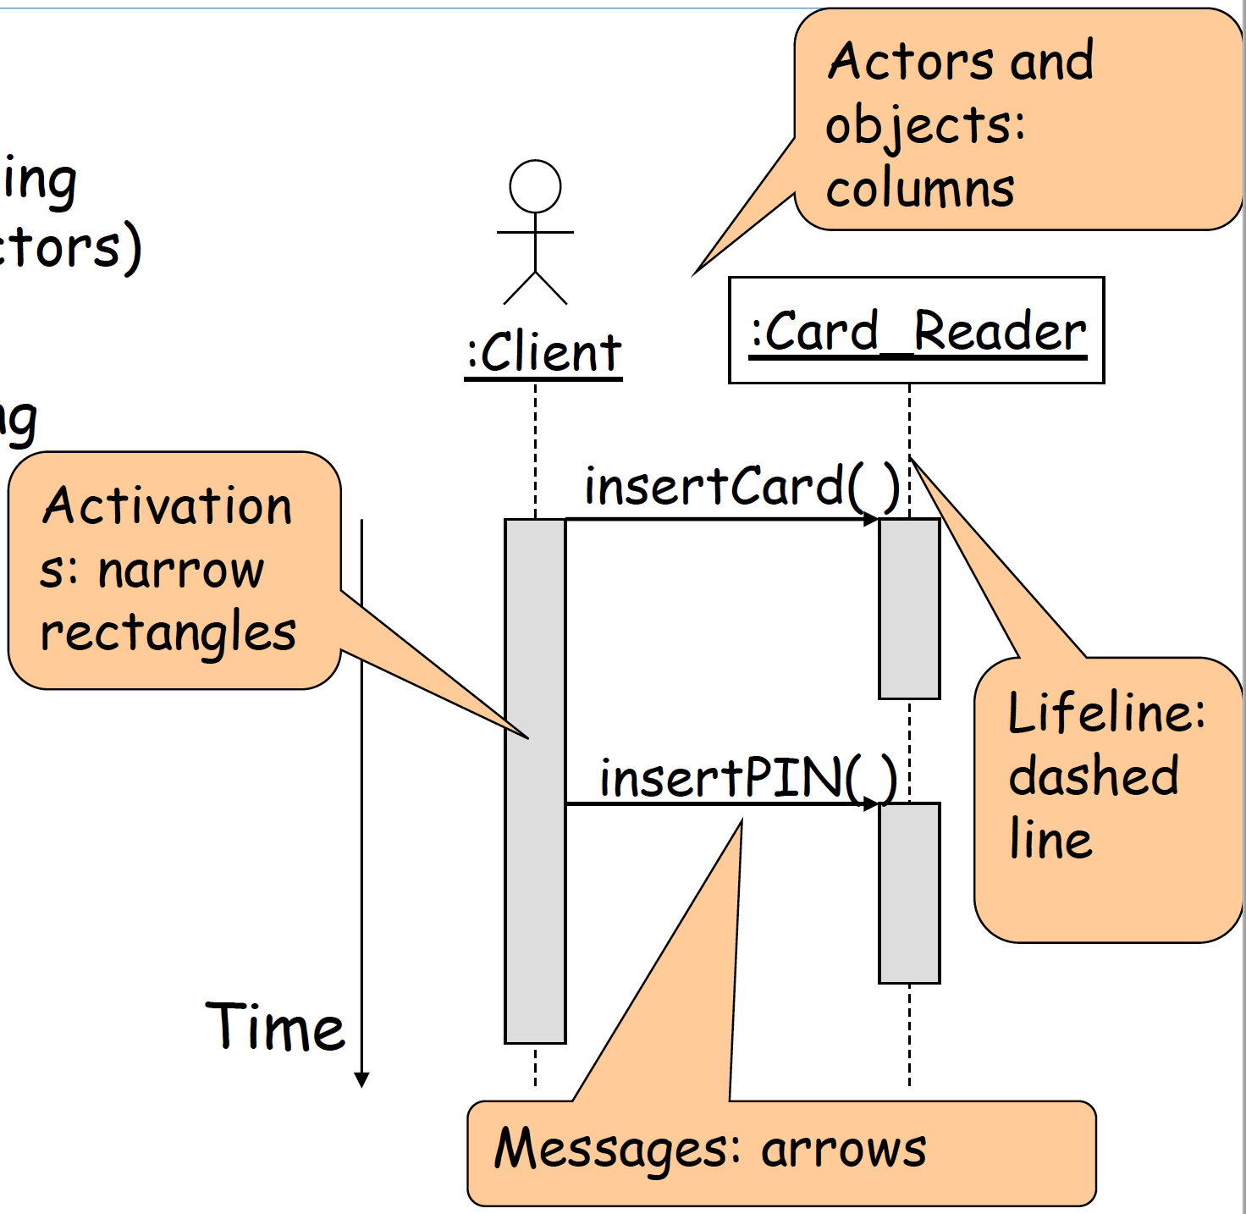

Key Parts of a Sequence Diagram
Participant: an object (including instances of actors);
Message: communication between objects
the axes in a sequence diagram:
– horizontal: which object/participant is acting
– vertical: time ( forward in time)

Slide 9
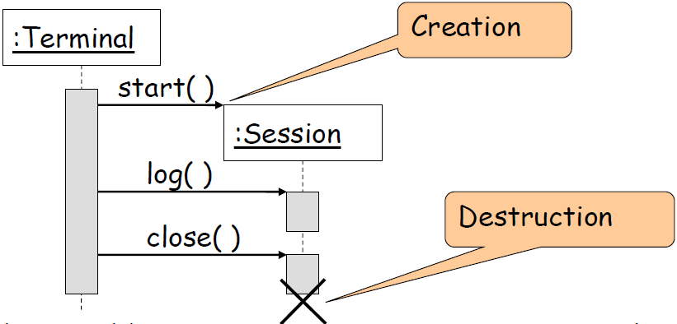
Creation and Destruction
Creation is denoted by a message arrow pointing to the object.
In garbage collection environments, destruction can be used to denote the end of the useful life of an object

Slide 10
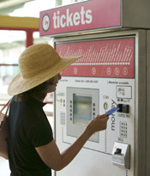
Example
Self-service machine, three objects do the work we're concerned with
the front: the interface the self-service machine presents to the customer
the money register: part of the machine where moneys are collected
the dispenser: which delivers the selected product to the customer

Slide 11
Example
The instance sequence diagram may be sketched by using this sequences:
1.The customer inserts money in the money slot
2.The customer makes a selection
3.The money travels to the register
4.The register checks to see whether the selected product is in the dispenser
5. The register updates its cash reserve
6. The register has a dispenser deliver the product to the front of the machine

Slide 12
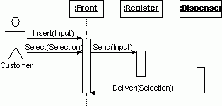
Example
Notify()
The "Buy a product" scenario.
Because this is the best-case scenario, it's an instance sequence diagram

Slide 13
… But
We have seen an instance of an interaction diagram- one possible sequence of messages
Since a use case can include may scenarios
There is a need to show conditional behaviour
There is a need to show possible iterations
A generic interaction diagram shows all possible sequences of messages that can occur

Slide 14
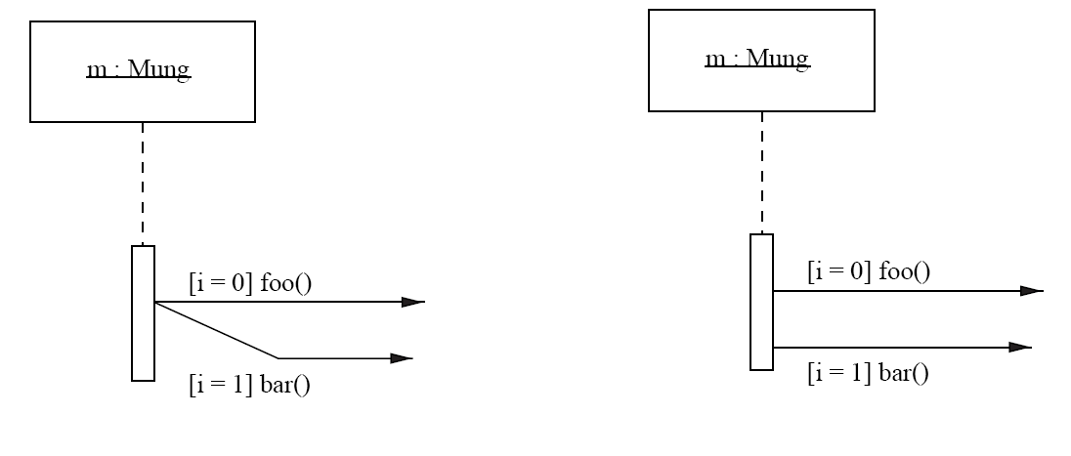
Showing conditional behavior
A message may be guarded by a condition
Messages are only sent if the guard evaluates to true at
the time when the system reaches that point in the interaction
Obj:class
Obj:class
If i=0 then foo()
If i=1 then bar()
If i=0 then foo()
If i=1 then bar()

Slide 15
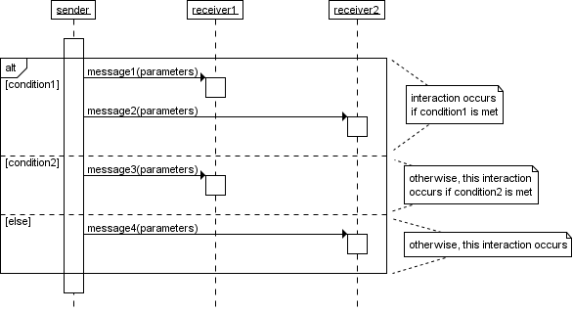
alt: Operators in interactions frames – UML 2.0
Operator
Guard
Alternative multiple fragment: only the one whose condition is true will execute

Slide 16
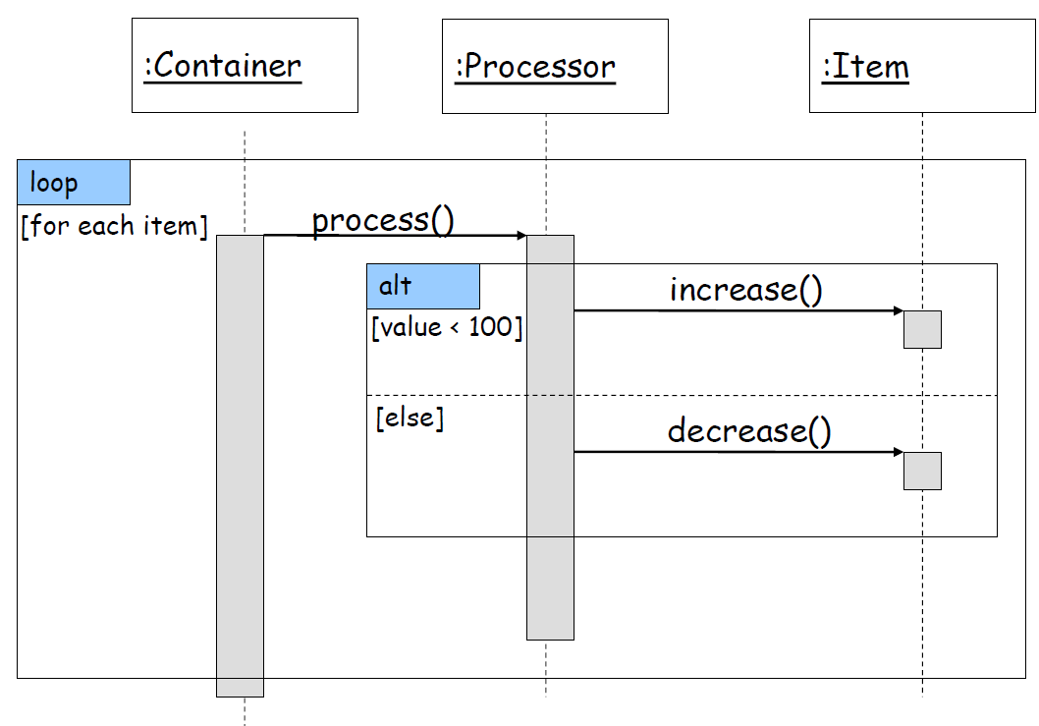
Interaction Frames

Slide 17
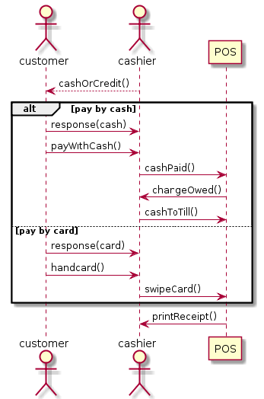
Conditional Behavior
Operator
Guard
Alternative multiple fragment: only the one whose condition is true will execute

Slide 18
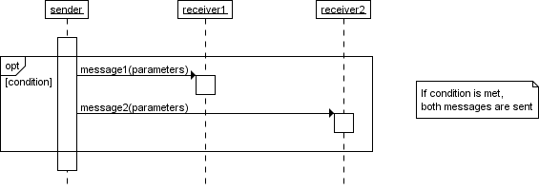
Opt in UML 2.x
Opt:Optional; the fragment executes only if the supplied condition is true.
This is equivalent to an alt with one trace

Slide 19
Iterations (i.e., loop) – UML 1.x
* Indicates looping or iterations
i:=1..2 means 2 iterations….
If you have seen it?
Earlier UML versions: UML 1.0
Result: ab ab

Slide 20
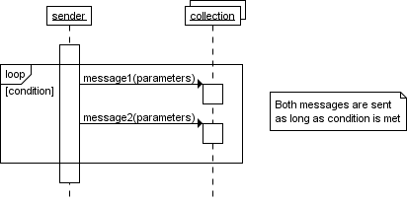
Loop in UML 2.x
Guard
Loop:the fragment may execute multiple times, and the guard indicates basis
for iterations

Slide 21
Loops
Guard

Slide 22
Sequence diagram of library

Slide 23
Showing timing constraints on a sequence diagram
time

Slide 24
Interaction types in sequence diagrams
Some UML
versions use
for both

Slide 25
Example
synchronous
An e-mail sent to the system
Student submitting a choice to the web
return
Asynchronous

Slide 26
Asynchronous Call Example
Asynchronous messages are sent from an object that will not wait for a response from the receiver before continuing its tasks.

Slide 27
Other notions: Branching
The life time of any object which could be affected
by a conditional message is split into branches

Slide 28
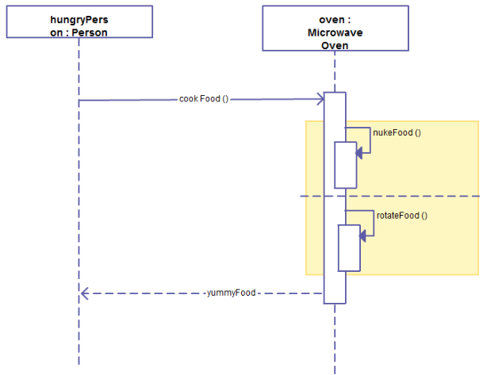
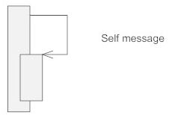
Nested Activation
Self Message (self-call) A message an object sends to itself, usually shown as a U shaped arrow pointing back to itself.
One method calling another method belonging to the same object;
or a recursive call of an operation

Slide 29
Interaction Frame Operators
Operator | Meaning
alt | Alternative; only the frame whose guard is true will execute
opt | Optional; only executes if the guard is true
par | Parallel; frames execute in parallel
loop | Frame executes multiple times, guard indicates how many
region | Critical region; only one thread can execute this frame at a time
neg | Negative; frame shows an invalid interaction
ref | Reference; refers to a sequence shown on another Diagram
sd | Sequence Diagram; used to surround the whole diagram (optional)

Slide 30


Synchronous and Asynchronous Calls
Synchronous message: wait until the message is done.
Asynchronous message: continue processing and doesn't have to wait for a response.
Filled arrowhead
and stick or half stick arrowhead
e.g. A bank customer could apply for credit card but can receive banking information over the phone or request money from an ATM, while waiting to hear about the credit application.
preferred

Slide 31
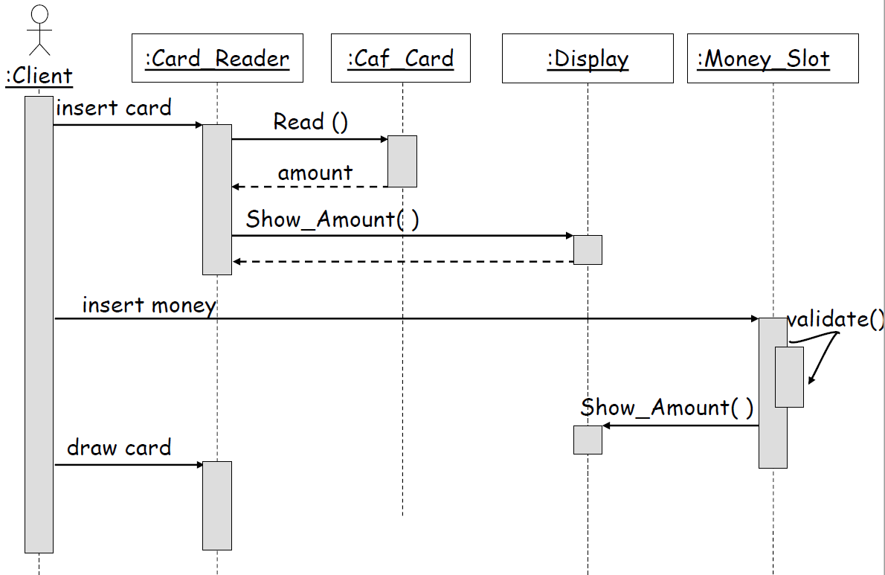
Example: Pay Food in Café

Slide 32
From Use Cases to Sequence diagrams
Sequence diagrams are derived from flows of events of use cases.
An event always has a sender and a receiver
- Find the objects for each event
Relation to object identification
Objects/classes have already been identified during object modeling
Additional objects are identified as a result of dynamic modeling

Slide 33

Exercise: Draw Sequence Diagram for money withdraw in SmartBank
Overview of banking systems
SmartBank is an online banking system that allows the customer to perform all the available actions through an ATM screen. The system can also be accessed by bank staff to perform the actions through cashiers. The system should provide basic operations such as deposit money, withdraw money, transfer money and agree to make loans to their customers. The bank cashiers can create new bank accounts to customers, search for customers’ accounts, update/view customer personal details and close customers bank account.
Search account
<<extend>>
Withdraw
View details
<<extend>>
Update details
Deposit
Transfer
customers
Make loan
Cashier
Open account
Close account

Slide 34
Money withdraw sequences
Assume:
Cashier will do the money withdrawing at the bank. You will give the card to the cashier
Pin has been validated
1. The cashier inputs withdraw amount
2. The request is sent to the corresponding account
3. The account notifies the account controller to perform the transaction.
4. The account controller withdraws successfully.
5. The account notifies the system the withdraw is successful.
6. New balance is displayed.
7. Cash is dispensed to the cashier.
8. The cashier takes the cash.
9. The system asks if there is more request.
10. The cashier terminates the conversation.
11. Receipt is printed.
Notes:
Flow of event is more detailed than the scenario for use cases.

Slide 35
:Cashier
:Display
:Account
:AccountController
1: EnterAmount()
2: ProcessTransaction(amount)
3:WithdrawAmount()
4:WithdrawSuccessful()
5:TransactionSuccessful()
6:DisplayAmount()
7:DispenseCash()
8: TakeCash()
9: MoreRequest()
10: Terminate()
11: PrintReceipt()
Notes:
Assume:
Cashier will do the money withdrawing at the bank. You will give the card to the cashier
Pin has been validated

Slide 36
When to use sequence diagrams
Comparing Design Options
Shows how objects collaborate to carry out a task
Graphical form shows alternative behaviours
Assessing Bottlenecks
E.g. an object through which many messages pass
Explaining Design Patterns
Enhances structural models
Good for documenting behaviour of design features
Elaborating Use Cases
Shows how the user expects to interact with the system
Shows how the user interface operates

